Slide 1
OPERATION ARCTIV CITADEL (OPAC)
Introduction Brief
CAO: 2024-12-27
Version: 0.1
Notes:
Changes:
1.1: Minor updates to correct the brief IAW actual situation.

Slide 2
AGENDA
Situation / Road to war
Functions/Roles
Products
Generic timeline
Information flow/ Where to find information

Slide 3
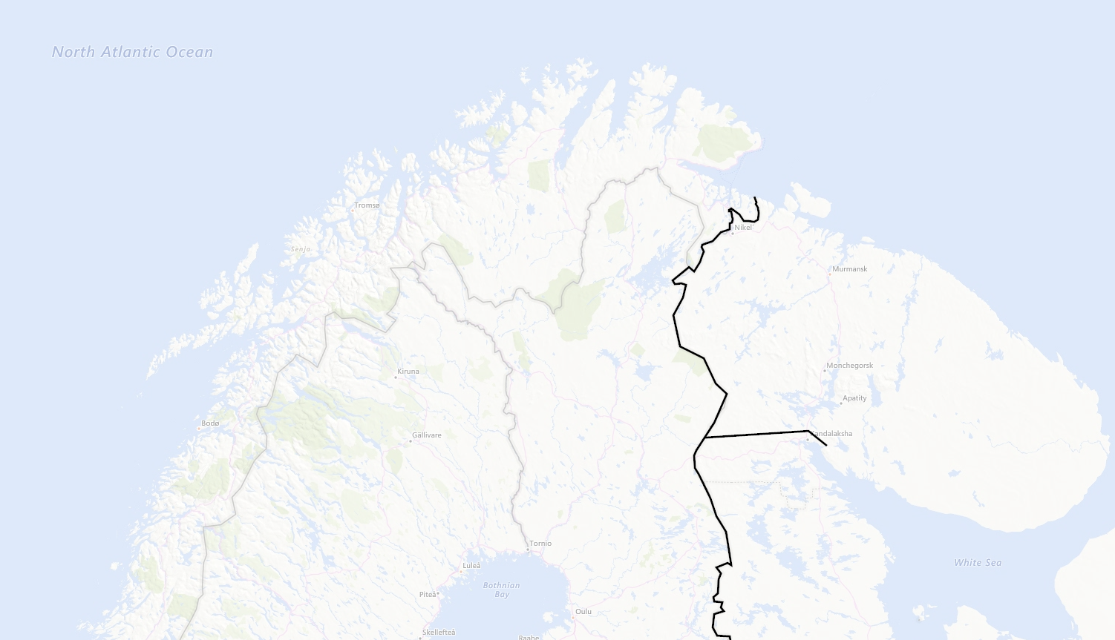


LOCATIONS
NORWAY
NOTIA
SWEDEN
FINLAND
KAMBILAND

Slide 4
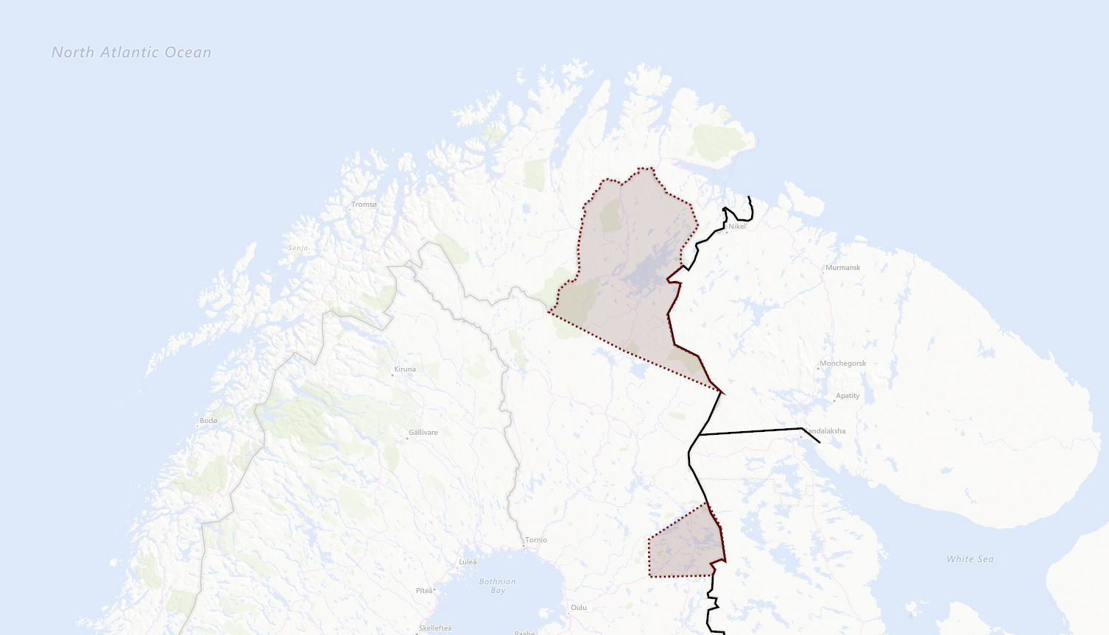


CONTESTED TERRITORY
Notian claims in Northern Finland
FINLAND
Kambiland settlements in Finland

Slide 5

SITUATION & TIMELINE (1 of 2)
Time at start of campaign: 20th September 2011 (D0)
Notia have over years claimed part of Northern Finland as part of Notia after WW2.
The last year Notia have increased their posture toward Finland and had public statement regarding protecting Notian nationals in Notian claimed territory in Northern Finland while also expressing offensive ambitions and need to create strategic depth and move defenses forward.
Notia have expressed concern about the Notian nationals living in Northern part of Finland and have urged UN to protect their rights.
Notia have expressed a willingness to intervene to protect Notian nationals everywhere in the world.
The last 3 weeks we have seen a buildup of military forces in Notia indicating higher activity than normal. Notia have stated that this is part of their national exercise FROST. The exercise is scheduled to last until 23rd of September 2011.
In the area of Kuusamo in Finland there are several settlements that have a majority of Kambiland inhabitants.
Kambiland have not an overt offensive posture in the same manner that Notia and have traditionally had good relations with Finland regarding the Kamibland nationals in Finland
Notian claims in Northern Finland
Kambiland settlements in Finland

Slide 6
SITUATION & TIMELINE (2 of 2)
Time at start of campaign: 20th September 2011 (D0)
Finland are feeling threatened and are assessing the situation as serious and that Notian plans to follow up threats and seize the Notian claims territory in Northern Finland before 2012.
Finland have asked for support from its close allies, and a close group of allies have created Combined Joint Task Force – 23 (CJTF 23) with both air, ground and naval units from different countries.
CJTF-23 aims to bolser Finnish defenses and deter and prevent an invasion from Notia.
CJTF-23 are tasked with creating contingency plans for attack on Notia to destroy Notian offensive capability if tasked by political authorities.
Notian claims in Northern Finland
Kambiland settlements in Finland

Slide 7
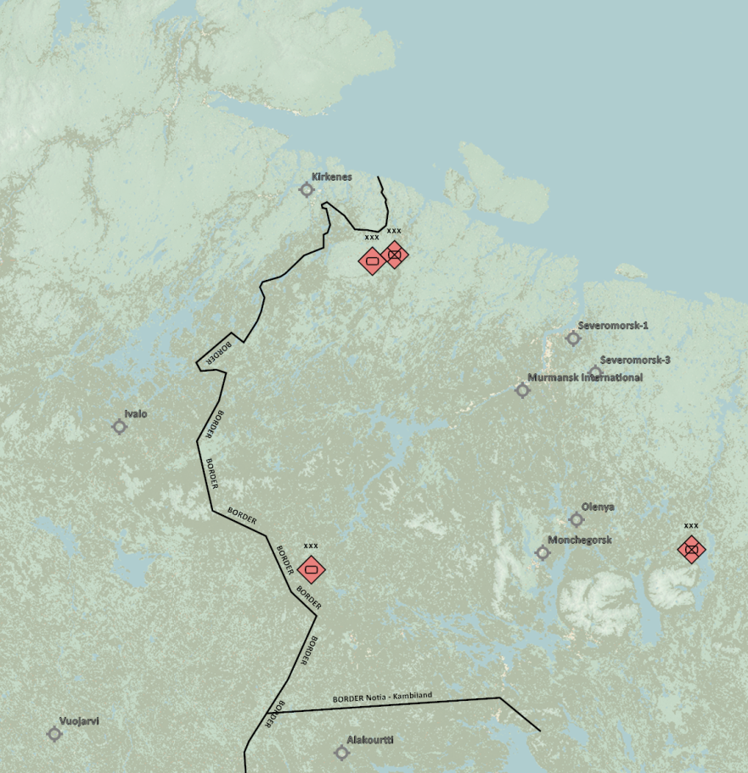
MILITARY SITUATION
Notia ground force dispositions:
1st Corps have left bases and are in training area conducting exercise FROST.
2nd Corps have partially left base complex and are taking part in exercise FROST.
3rd Corps have left bases and are in training area conducting exercise FROST.
4th Corps are currently not mobilized and are at homebase.
Air Forces IAW INTREP VID OPAC-001 - Enemy Air Assets in Notia and Kambiland
Notian strategic IADS IAW: INTREP VID OPAC-002 - Notia IADS
For details see intelligence page on OPAC briefing page: OPAC Intelligence (WIP/TBI)
Kambiland ground force disposition:
Kambiland forces are at home bases
2nd Corps
1st Corps
3rd Corps
4th Corps

Slide 8
ACTORS - Allied
Norway
Norway have granted overflight and movement rights for allied forces in support of Finland.
Norway are supporting with military aid, and the flow of goods to Finland.
Norway have allowed bases to be used for operations toward Notia or Kambiland without restrictions ( Bodø, Andøya, Bardufoss and Banak).
Finland
Finland is the country that have asked for support from allies.
Finland are hosting CJTF-23 operations from all bases and infrastructure.
Sweden
Sweden have granted overflight and movement rights for allied forces in support of Finland.
Sweden are supporting with military aid, and the flow of goods to Finland.
Sweden have not allowed Swedish bases to be used for operations toward Notia or Kambiland

Slide 9
ACTORS - Adversaries
Notia
Notia is a vast, iron-fisted state reminiscent of the Soviet Union at the height of the Cold War. Governed by a single-party regime, power is centralized in the Supreme Council, presided over by a stern Premier who controls nearly every aspect of civilian and military life. The nation’s sprawling industrial complexes churn out tanks, aircraft, and propaganda alike, reinforcing a massive military apparatus. Despite the strict internal security imposed by the secret police, Notia’s people hold onto a sense of collective pride in their shared heritage and technological achievements. This mix of authoritarian control and fierce national identity makes Notia a formidable force on the global stage.
Kambiland
Kambiland is the “little brother” to Notia, forged from the cultural tapestry of shared bond of hardness. An authoritarian regime led by a formidable Supreme Leader wields near-total power, upheld by a sprawling security apparatus that cracks down on any hint of dissent. Despite longstanding economic challenges, vast natural resources and fervent nationalism fuel Kambiland’s aspirations. Its strategic alliance with Notia serves to bolster both nations’ military and political leverage, reflecting a bond that balances regional dominance with cultural ties. While a powerful state in its own right, Kambiland’s identity and future remain closely linked to the ambitions of its elder ally
Enemy: is actively opposed or hostile to CJTF and friendly forces.
Adversary: opponent in a contest, conflict, or dispute toward CJTF and friendly forces.
Neutral: not supporting or helping either side in a conflict, disagreement, etc.; impartial.

Slide 10

ACTORS - Adversaries
Democratic Union of Socialist States (DUSS)
China, Notia and Kambiland are allied as part of DUSS.
China
China are the lead nation of DUSS and are projecting power worldwide using air and maritime assets.
Syria
Syria is affiliated with DUSS and a supporting member, but not yet a full member of the alliance.
Iran
Iran is affiliated with DUSS and a supporting member, but not yet a full member of the alliance.
Libya
Libya is affiliated with DUSS and a supporting member, but not yet a full member of the alliance.
Enemy: is actively opposed or hostile to CJTF and friendly forces.
Adversary: opponent in a contest, conflict, or dispute toward CJTF and friendly forces.
Neutral: not supporting or helping either side in a conflict, disagreement, etc.; impartial.

Slide 11
FUNCTIONS / ROLES
Combined Joint Task Force Headquarter (CJTF HQ): Mission maker/event host
Joint Force Air Component Commander (JFACC): Volunteer 132nd members/externals
Air Operations Centre (AOC): JFACC volunteers take turn
Virtual Intelligence Directorate (VID): Mission maker/event host
Virtual Intelligence Service (VIS): Volunteer 132nd members/externals
LCC Land Component Commander (LCC) – If interest, can be filled by volunteers (need minimum 3)
Maritime Component Commander (MCC) - If interest, can be filled by volunteers (need minimum 3)

Slide 12
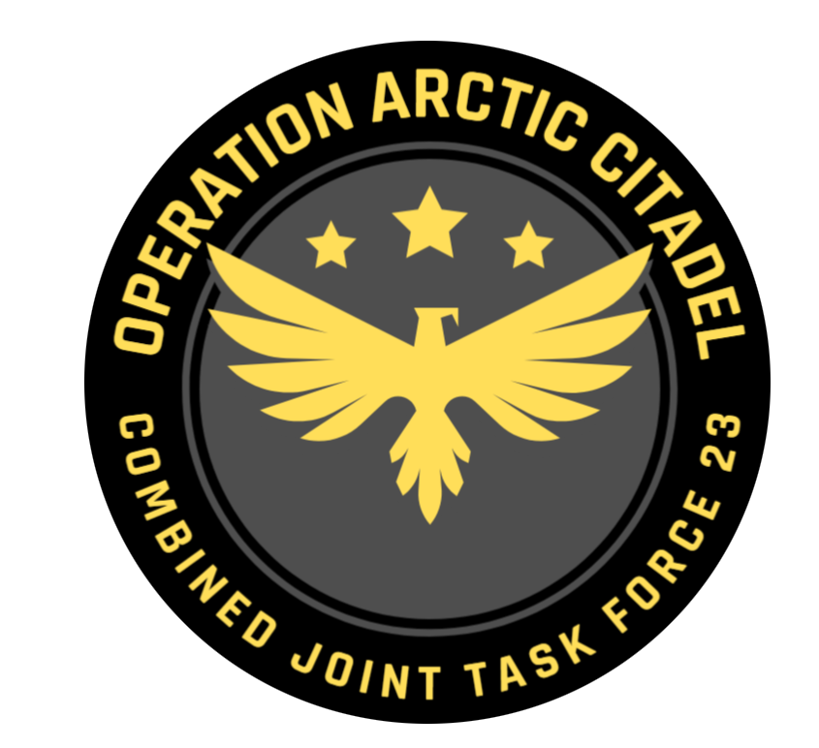
CJTF – 23 HQ
Commander of the entire force (Air, maritime and land forces)
Mission designers /event host
Ensures to streamline events

Slide 13

JFACC
Commander of Air Forces involved in the operation
Volunteer 132nd members
Takes guidance from CJTF-82 HQ, available intelligence, supported by VIS, to develop and execute the air campaign.
For details:
See JFACC Instructions (LINK)

Slide 14

AOC
Translates JFACC daily guidance (Air Operations Directive, AOD) into a executable Air Tasking Order
One member from the JFACC team, responsible for the taskings for that specific event IAW JFACC guidance

Slide 15

VID
Higher echelon intelligence agency.
Mission designers /event host
A way for mission designers/event hosts to introduce intelligence into the scenario.
Reports will be forwarded to VIS

Slide 16

VIS
Intelligence agency that supports operations
Volunteer 132nd members
Most of the operation will be intelligence driven, and that intelligence will come from events.
For details:
See VIS Instructions (LINK)

Slide 17
VIS Cycle (Per ATO Day)
Targeting Cycle
Process raw intel
Plot locations on .cf
Update OOB
Update IR list
Update VIS Timeline
Analyse intel
Prepare new .cf summaries
Determine COAs
Update IR list
Targeting meeting planning
Decide target recommendations
Prepare presentation
Present intel
Ideally only once VIS know JFACC's plan
Produce any further deliverables that may be needed (e.g. .cf layers, extra info on particular targets)
Targeting Meeting
See TTP for rough agenda
VIS present first
JFACC present next
Discuss target priorities
Pilots fly mission and report intel
Should all be reported in Campaign Manager
Sometimes need to look at AARs as well
VID summary and JFC Guidance can also provide further info

Slide 18
PRODUCTS
CJTF-23 Operation order (OPORDER)
JFACC Joint Air Operations Plan (JAOP)
SPINS (Special Instructions)
Airspace Control Plan
Air Operations Directive (AOD)
Airspace Control Order
Joint Target List (JTL)
Joint Prioritized Target List (JPTL)
Time Sensitive Target (TST) Matrix
Intelligence Report (INTREP)
Basic Intrep (Common to all 132nd events)
OPAC specific reports (Specific to OPAC only)
Intelligence Summary (INTSUM)
Per Event
Target Folder (TF)
Combatflite layers

Slide 19
PRODUCTS
Introduction brief
OPORDER
JTL
SPINS
INTREP X
JAOP
INTREP Y
INTREP Z
CAMPAIGN DOCUMENTS
PER EVENT
INTSUM
JPTL /TST
AOD
ATO/EXECUTION

Slide 20
PRODUCTS - campaign
Introduction brief
OPORDER
JTL
SPINS
INTREP X
JAOP/ACP
INTREP Y
INTREP Z
CAMPAIGN DOCUMENTS
PER EVENT
INTSUM
JPTL /TST
AOD
ATO/EXECUTION

Slide 21
PRODUCTS – per event
Introduction brief
OPORDER
JTL
SPINS
INTREP X
JAOP/ACP
INTREP Y
INTREP Z
CAMPAIGN DOCUMENTS
PER EVENT
INTSUM
JPTL /TST
AOD/ACO
ATO/EXECUTION

Slide 22
PRODUCTS - Pilots/controllers
INTSUM
AOD/ACO
JPTL /TST
SPINS
Tasking
Execution

Slide 23
GENERIC TIMELINE
Minimum 14 days between each ATO day (real world days)
Each ATO day is broken down into two events (DX.1 and DX.2. Time between DX.1 and DX.2 can be one week or more).
Day 1: Event D1.2, campaign day 1 (Sunday) (Last event of the previous ATO day)
Day 2: AARs and BDAs to be provided by pilots (Monday)
Day 3-8: VIS production and publish new INTSUM NLT Day 8 (Monday)
Day 8-12: JFACC guidance to AOC (publish new AOD, NLT Day 12, Friday) (supported by VIS throughout)
Day 12: AOC work day: Taskings/briefing/assignments (Friday)
Day 13+14: Pilots planning days
Day 14: Event D2.1, campaign day 2 (Sunday)
Day 21: Event D2.2, campaign day 2 (Sunday)

Slide 24
INFORMATION FLOW
132nd Website
Taskings / ATO
AAR
OPAC Briefing page
Discord OPAC section: (OPAC tag given to participants for access, both 132nd and externals)
JFACC: JFACC internal channel for work related to AOD and JAOP revisions
VIS: VIS internal channel for work related to INTREP and INTSUMs
JFACC-VIS: Internal coordination channel between JFACC and VIS for JTL and JPTL. Only for VIS and JFACC.
RFI: Channel for everyone to request “official” information
Products: Channel for everyone where CJTF HQ, AOC or VID publish information (Mission makers(event hosts) (will also be made available on the OPAC briefing page)
Media: Channel for everyone where media reports may appear.
BDA/Reports: Channel for everyone where pilots report BDA and other reports relevant for VIS to produce INTSUM/INTREPs
Event planning: Channel for everyone where information for the next event can be coordinated and discussed.
OPAC coordination: Chanel for everyone where coordination can be done. Anything not suited for other discord channels

